Slide 1

So You Want to Build an App?

Slide 2
2.5 Million Mobile Apps
in 2014 via mashable + appannie
http://mashable.com/2015/01/15/google-play-more-apps-than-ios/

Slide 3
400% More Engagement Time
Stats via Adobe in 2014
https://blog.newrelic.com/2014/02/11/mobile-apps-mobile-site-engagement/

Slide 4
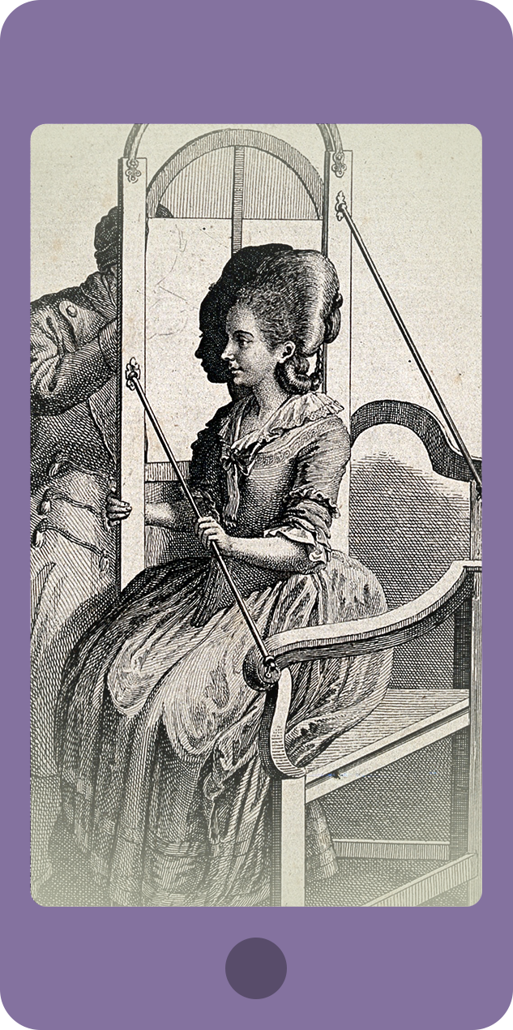
Who Is Your App For?
Identify your target audience

Slide 5
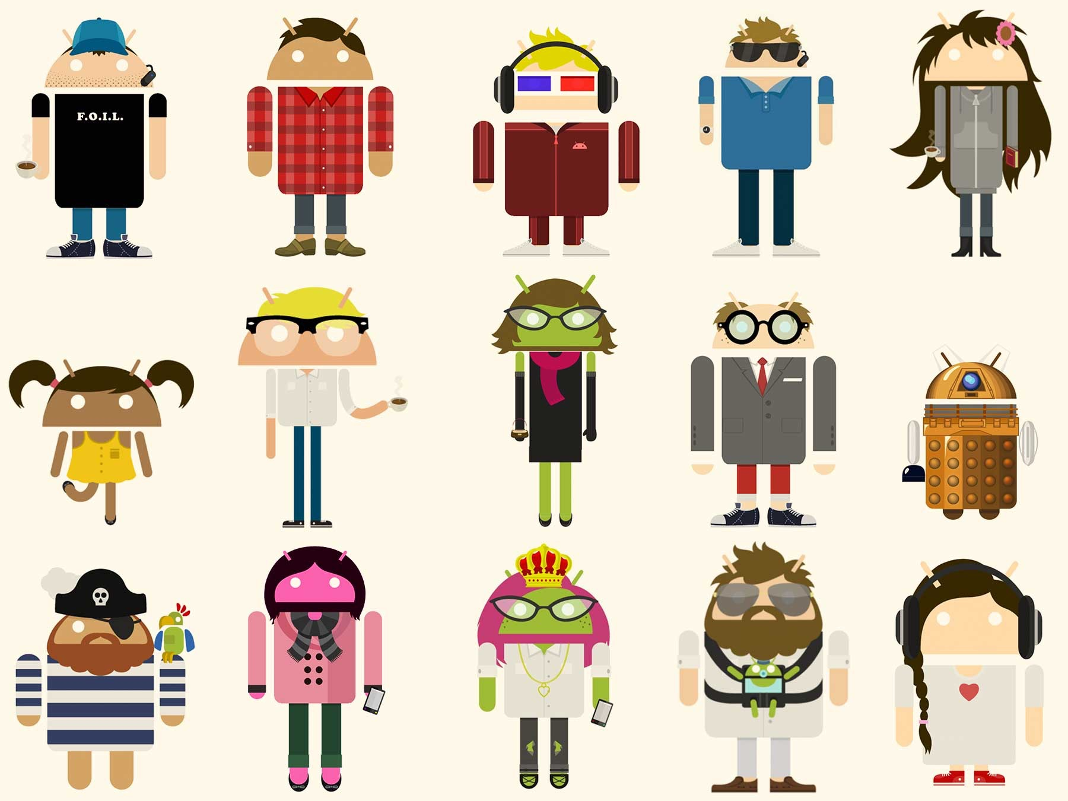

Slide 6
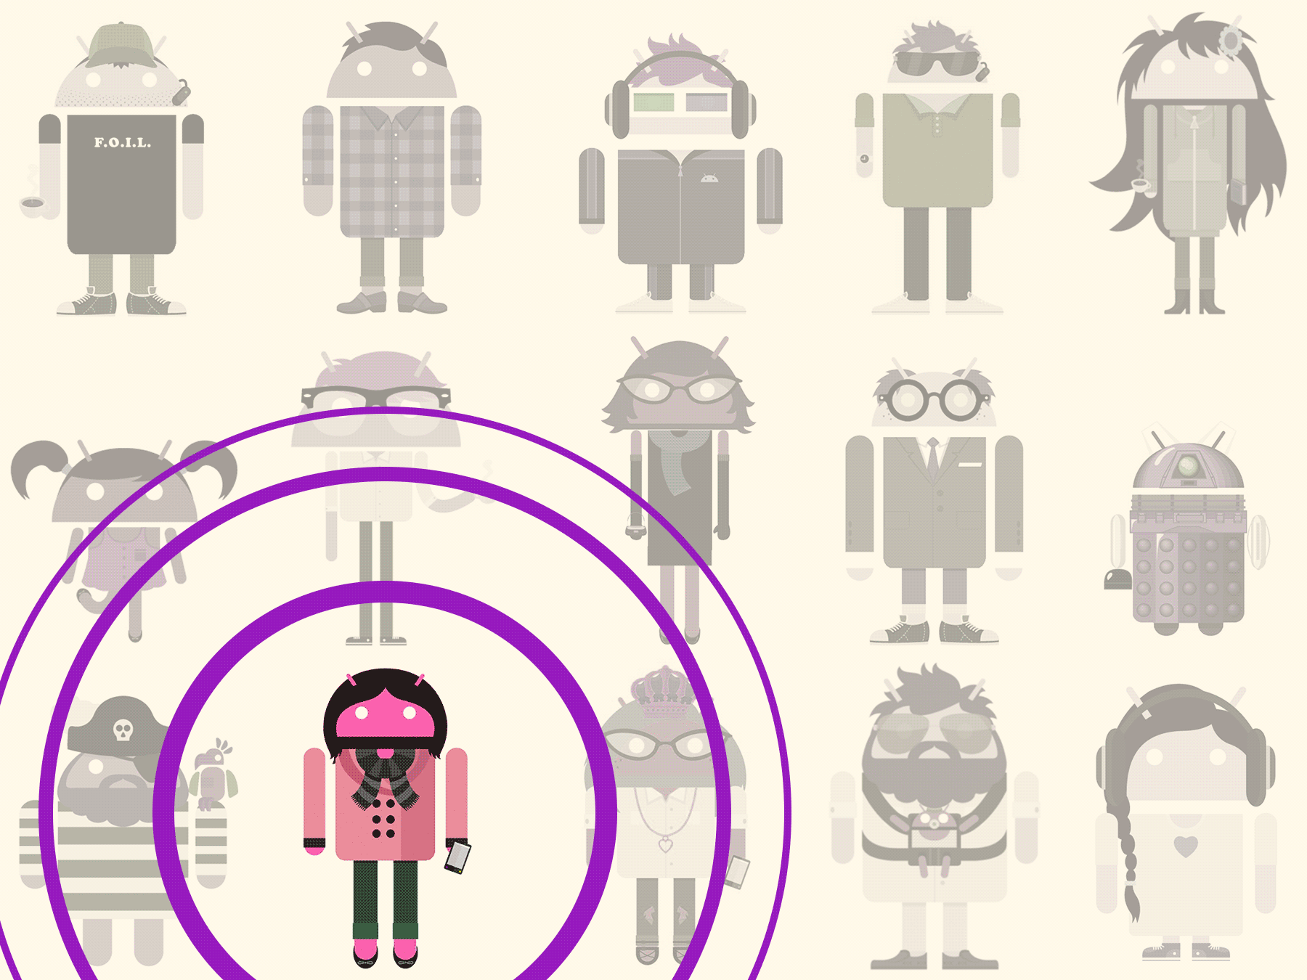

Slide 7
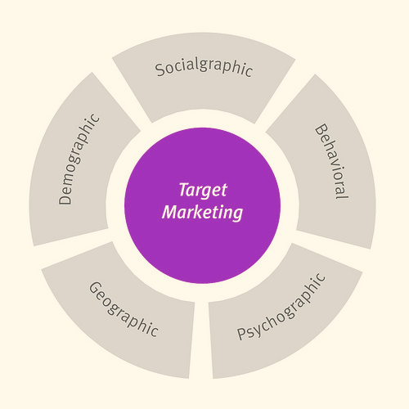

Slide 8
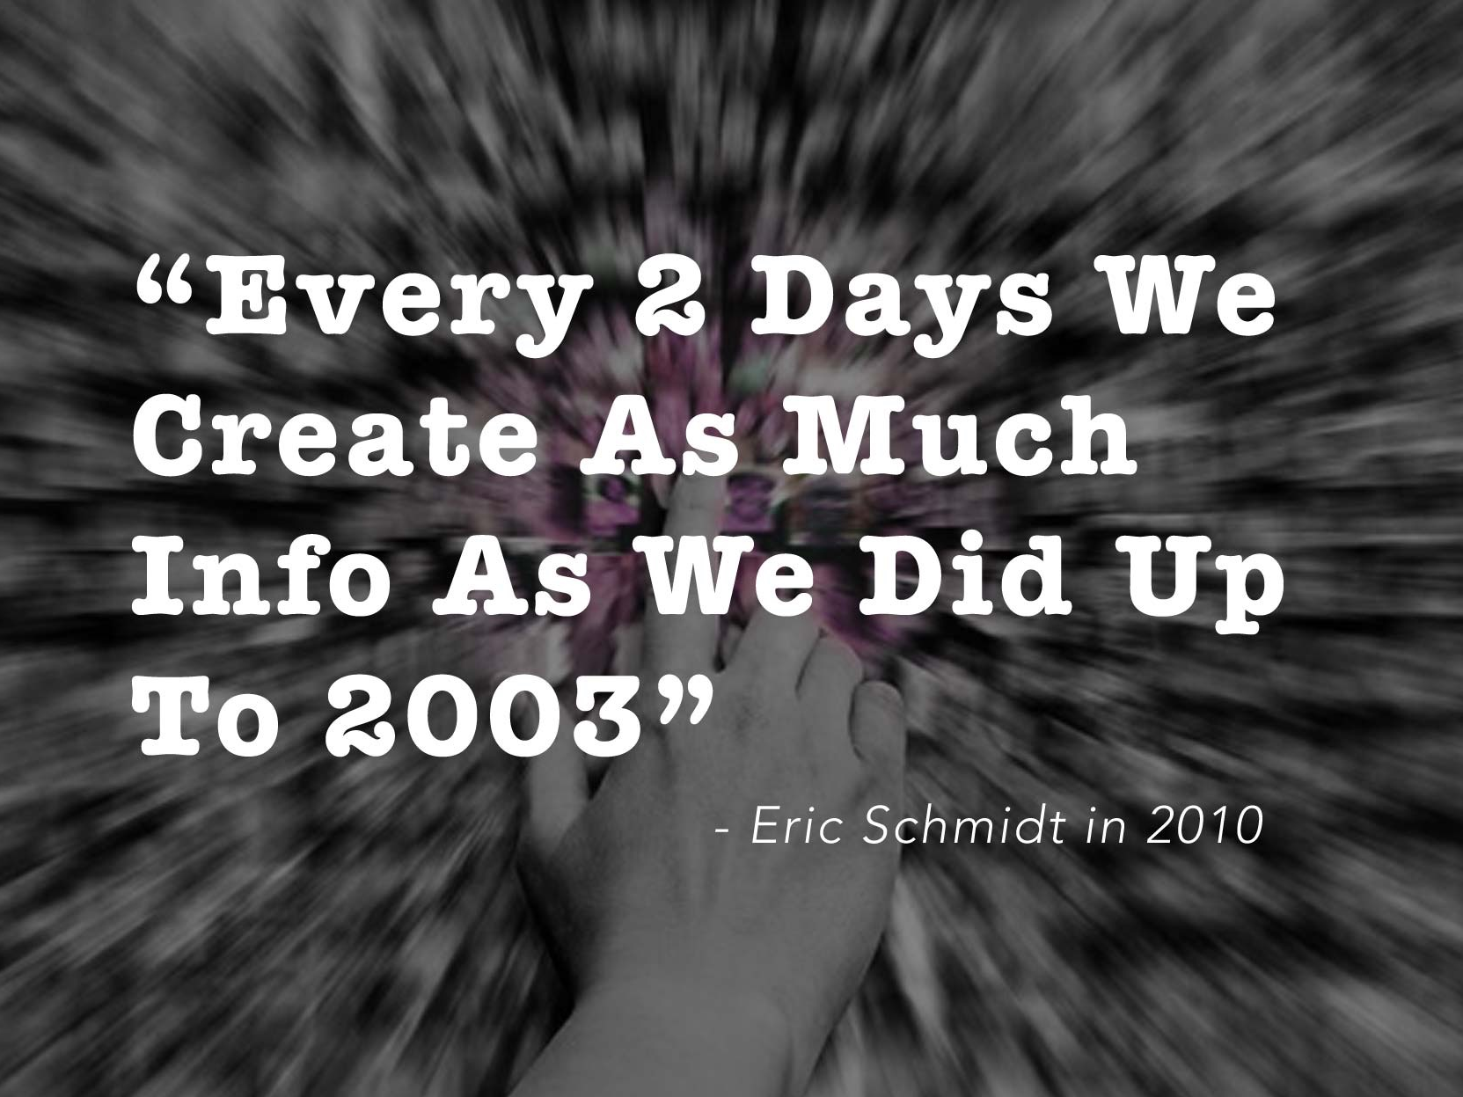

Slide 9
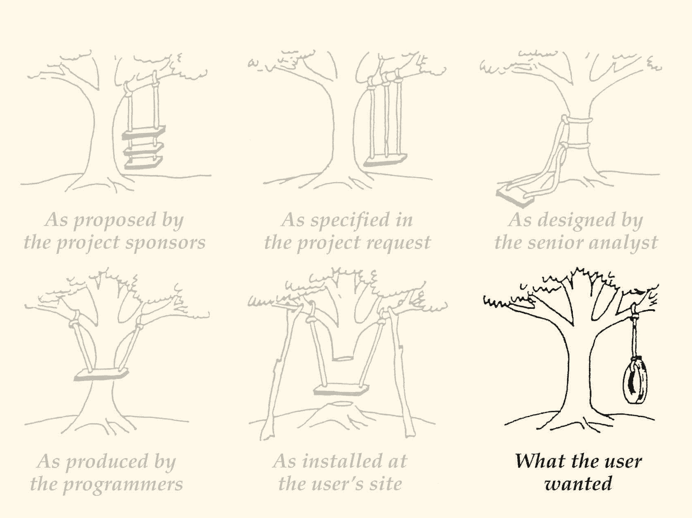

Slide 10
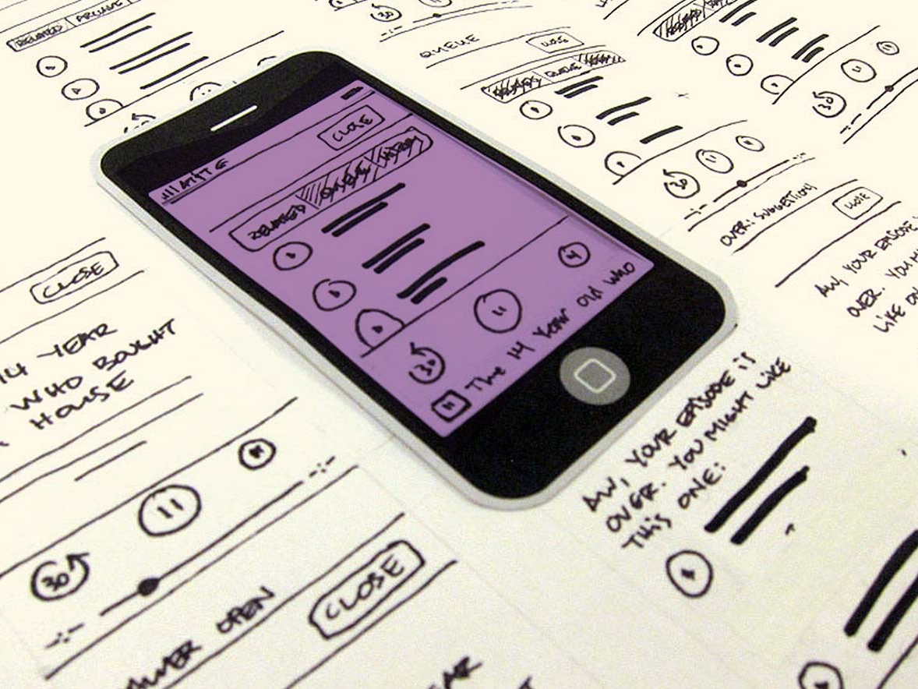

Slide 11
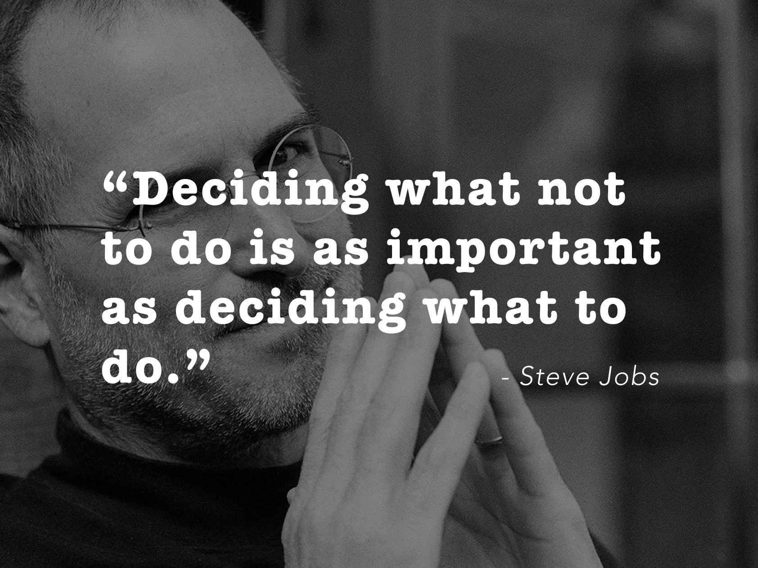

Slide 12


